Slide 1
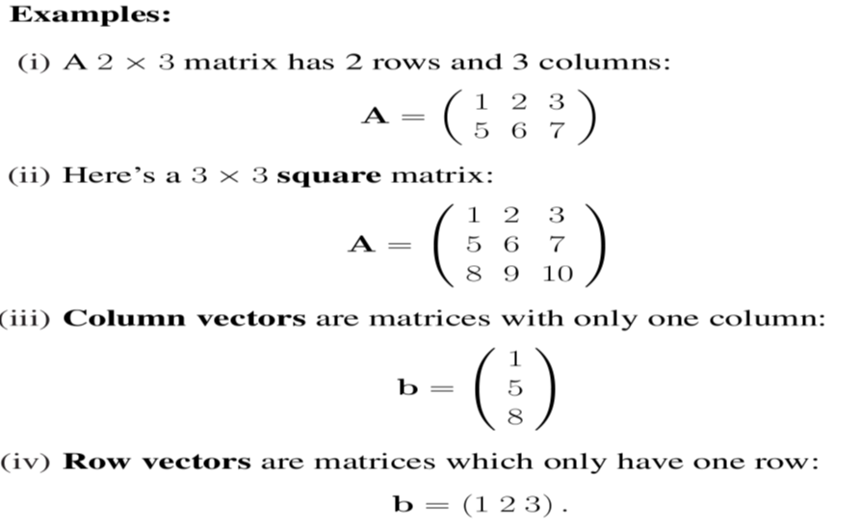
Mathematics Materials Lecturer: A.M.Alazzawe FIRST CLASS
1
ST
SEMESTER
Chapter7
Matrices and determinants
Matrices
Definition: An m×n matrix is a rectangular array of numbers (m rows and n columns) enclosed in brackets. The
numbers are called the elements of the matrix.
1

Slide 2
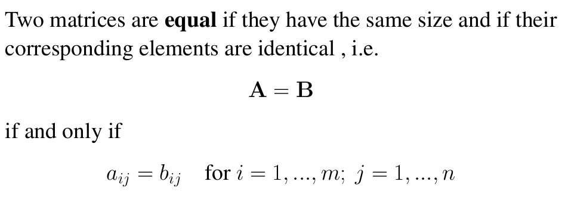
Mathematics Materials Lecturer: A.M.Alazzawe FIRST CLASS
1
ST
SEMESTER
We refer to the elements via double indices as follows
(i) The first index represents the row. (ii) The second index represents the column.
(a32) is the element in row 3, column 2 of the matrix A.
Use lowercase boldface (or underlined) letters for vectors
a b c (or a, b, c)
Use uppercase boldface (or underlined) letters for matrices
A B C (or A, B , C )
Refer to the respective elements by lowercase letters with the
appropriate number of indices e.g.
bi is a vector element
aij is a matrix element
Matrix algebra
Matrix addition
❖ Two matrices can only be added if they have the same size.
❖ The result is another matrix of the same size.
2

Slide 3
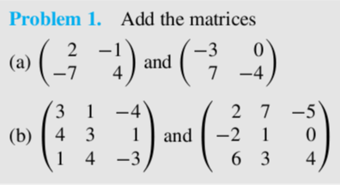
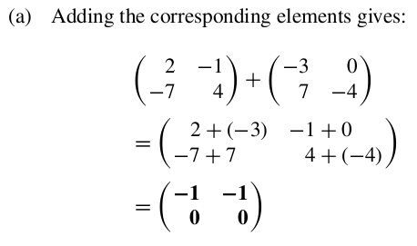
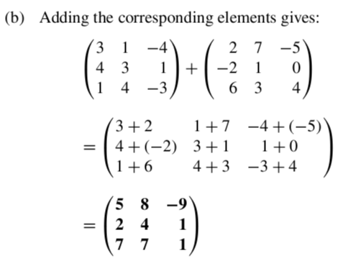
Mathematics Materials Lecturer: A.M.Alazzawe FIRST CLASS
1
ST
SEMESTER
❖ We add matrices by adding their corresponding elements, i.e.
A = B + C
is obtained (element-wise) via
aij = bij + cij for i = 1, ..., m; j = 1, ..., n
3

Slide 4
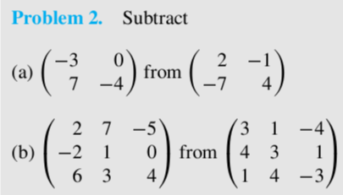
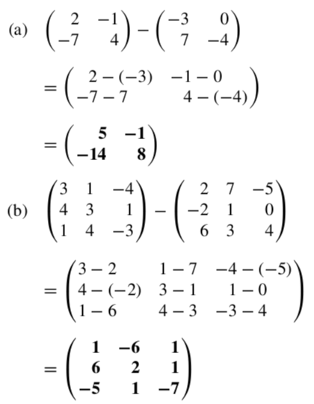
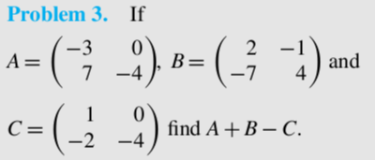
Mathematics Materials Lecturer: A.M.Alazzawe FIRST CLASS
1
ST
SEMESTER
4

Slide 5
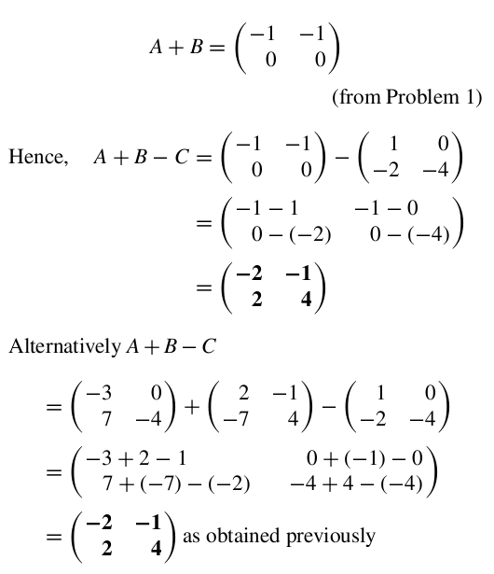
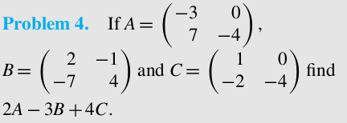
Mathematics Materials Lecturer: A.M.Alazzawe FIRST CLASS
1
ST
SEMESTER
Multiplication
When a matrix is multiplied by a number, called scalar multiplication, a single matrix
results in which each element of the original matrix has been multiplied by the
number.
5

Slide 6
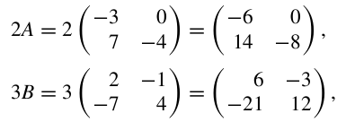
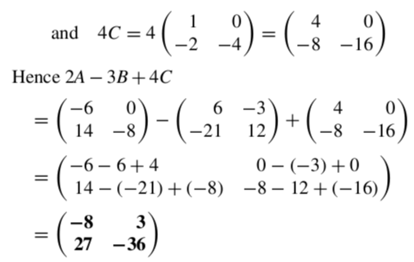
Mathematics Materials Lecturer: A.M.Alazzawe FIRST CLASS
1
ST
SEMESTER
EX.
Find
6

Slide 7
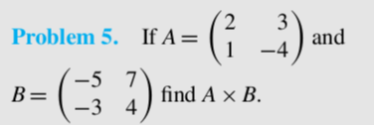
Mathematics Materials Lecturer: A.M.Alazzawe FIRST CLASS
1
ST
SEMESTER
7

Slide 8
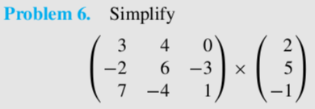
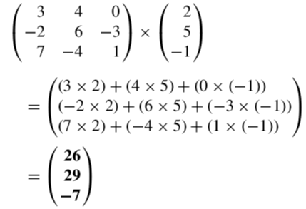
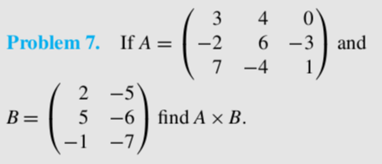
Mathematics Materials Lecturer: A.M.Alazzawe FIRST CLASS
1
ST
SEMESTER
3x3 * 1x3 =3x1
3 x 3 * 2 x 3 = 3x2
8

Slide 9
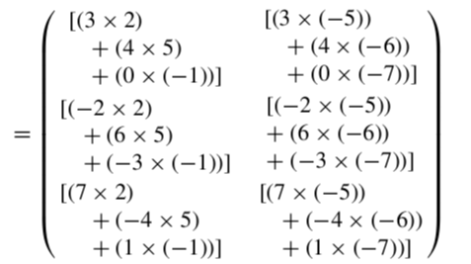
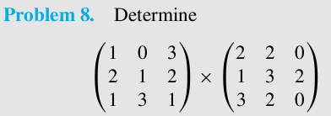
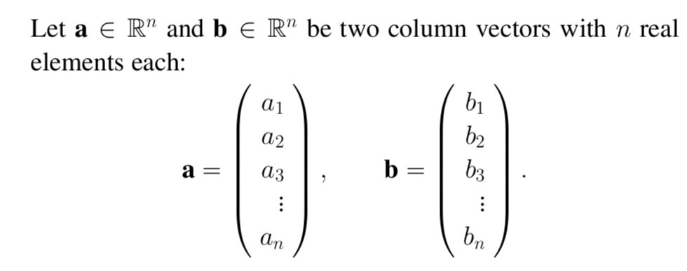
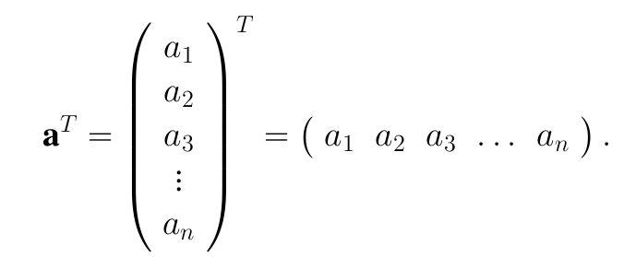
Mathematics Materials Lecturer: A.M.Alazzawe FIRST CLASS
1
ST
SEMESTER
9

Slide 10
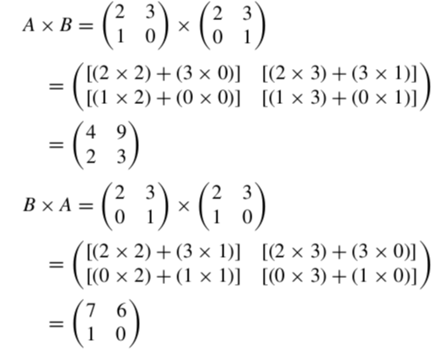
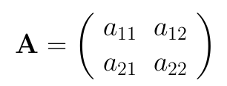
Mathematics Materials Lecturer: A.M.Alazzawe FIRST CLASS
1
ST
SEMESTER
Determinant of a matrix
10

Slide 11
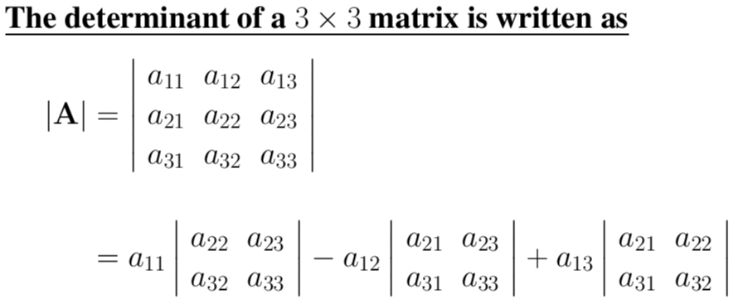
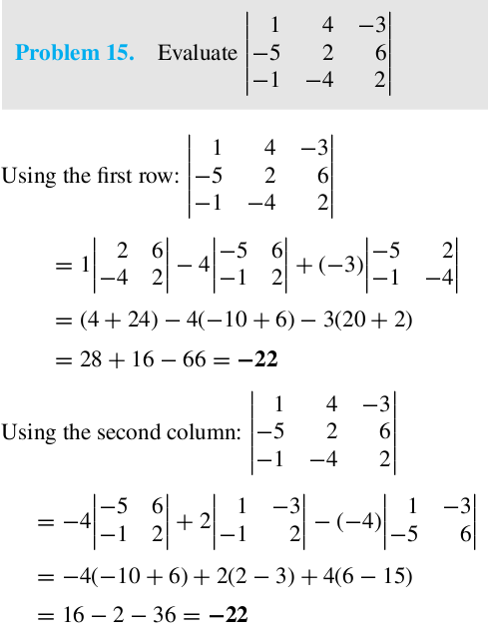
Mathematics Materials Lecturer: A.M.Alazzawe FIRST CLASS
1
ST
SEMESTER
That is the 3 × 3 determinant is defined in terms of determinants of 2 × 2 sub-matrices of A. These are called the
minors of A.
11

Slide 12
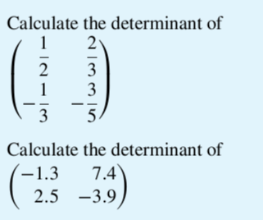
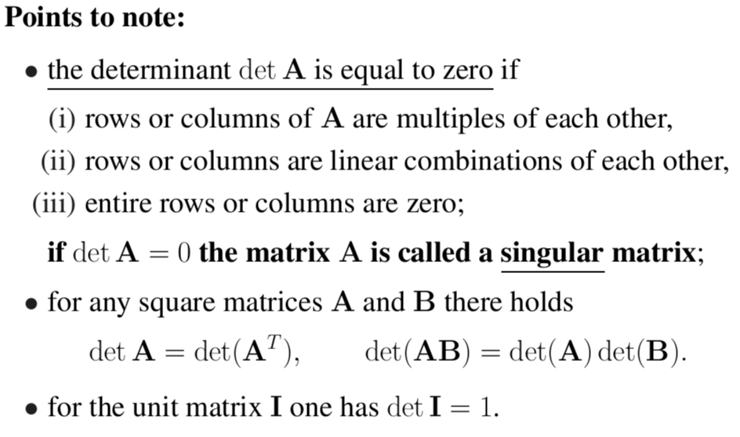
Mathematics Materials Lecturer: A.M.Alazzawe FIRST CLASS
1
ST
SEMESTER
12

Slide 13
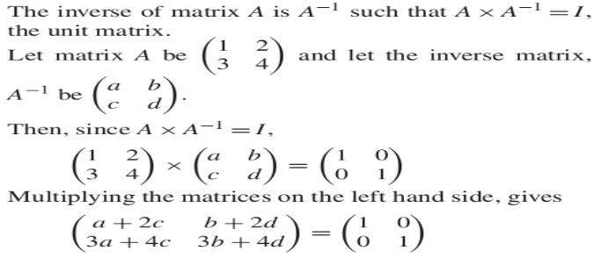
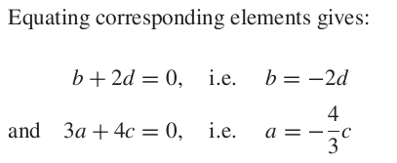
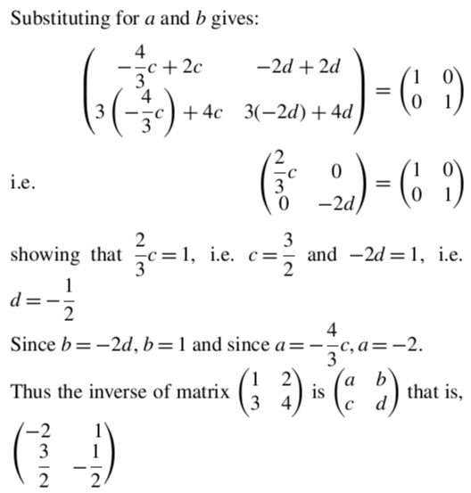
Mathematics Materials Lecturer: A.M.Alazzawe FIRST CLASS
1
ST
SEMESTER
THE INVERSE OR RECIPROCAL OF A 2 BY 2 MATRIX
13

Slide 14
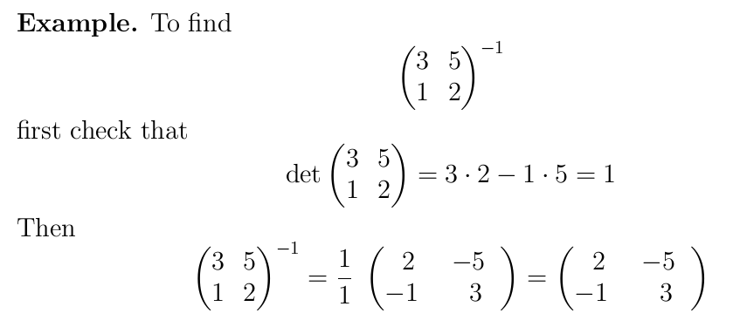
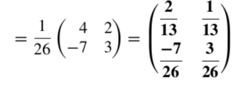
Mathematics Materials Lecturer: A.M.Alazzawe FIRST CLASS
1
ST
SEMESTER
14

Slide 15
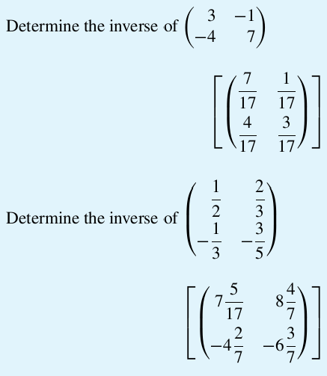
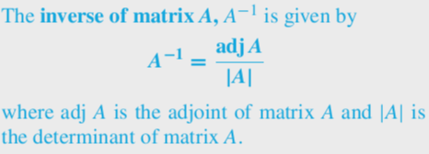
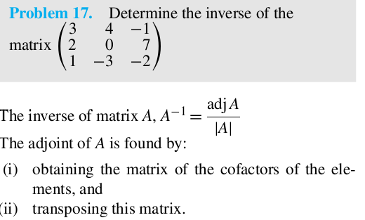
Mathematics Materials Lecturer: A.M.Alazzawe FIRST CLASS
1
ST
SEMESTER
THE INVERSE OR RECIPROCAL OF A 3 BY 3 MATRIX
15

Slide 16
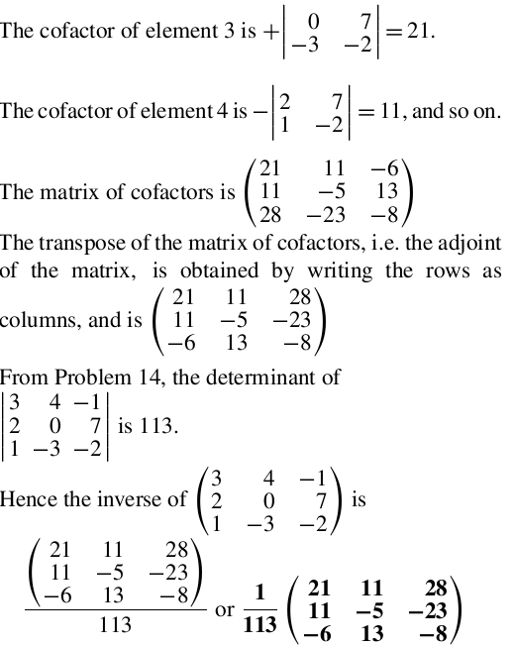
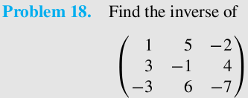
Mathematics Materials Lecturer: A.M.Alazzawe FIRST CLASS
1
ST
SEMESTER
16

Slide 17
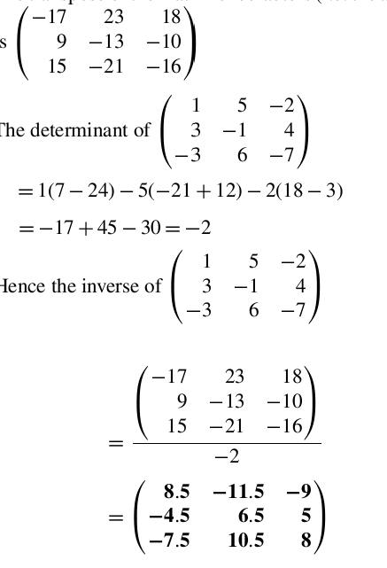
Mathematics Materials Lecturer: A.M.Alazzawe FIRST CLASS
1
ST
SEMESTER
17

Slide 18
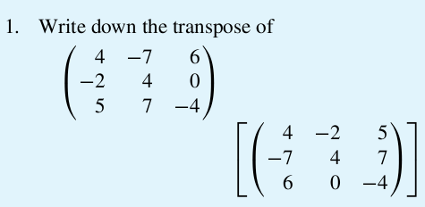
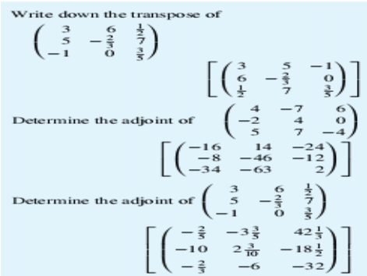
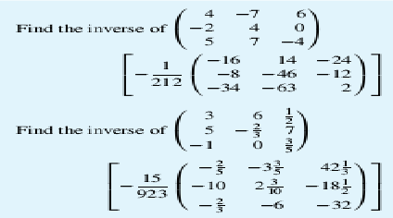
Mathematics Materials Lecturer: A.M.Alazzawe FIRST CLASS
1
ST
SEMESTER
18

